Slide 1
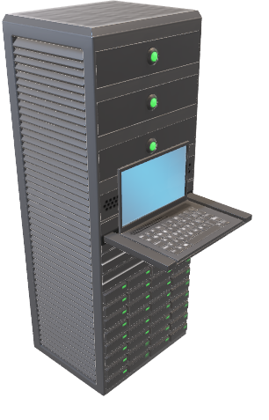
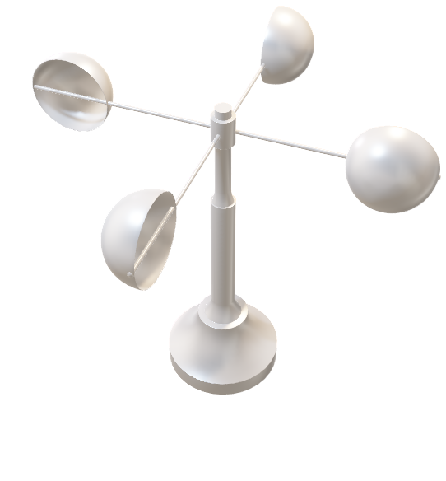

MARKET BASKET INSIGHT
Name : Athers freedon s
Reg.no : 212921104008
Dept/sem : cse/v
College : sjce2129

Slide 2
INTRODUCTION
Market basket analysis is a data mining technique used by businesses and retailers to discover patterns, relationships, and associations among items that customers frequently purchase together. The insights gained from market basket analysis can help businesses make informed decisions about product placement, marketing strategies, and inventory management
To perform market basket analysis, businesses typically use algorithms like Apriori, FP-growth, or association rule mining to discover item associations and generate actionable insights from transaction data. It's important to note that the effectiveness of market basket analysis depends on the quality and quantity of data available, as well as the specific goals and context of the analysis.

Slide 3
STEPS TO IMPLEMENT MARKET BASKET INSIGHT
Product Recommendations
Store Layout and Product Placement
Inventory Management
Fraud Detection
Supply Chain Optimization
Customer Experience Improvement
Promotion and Pricing Strategies
Customer Segmentation
Seasonal and Trend Analysis
Product Assortment Planning
Waste Reduction
Cross-Category Insights

Slide 4
Benefits Of Market Basket Analysis
Gaining market share: Once a business reaches its peak growth, finding new ways to do so might be difficult. Market basket analysis may be used to integrate gentrification and demographic data to locate the sites of new businesses or geo-targeted marketing.
Campaigns and promotions: MBA is used to identify the goods that work well together as well as the products that serve as the cornerstones of their product range.
Behavior analysis: A fundamental tenet of marketing is comprehending consumer behavior patterns. MBA may be used for anything, including UI/UX and basic catalog designs.
Optimization of in-store activities: MBA is useful in deciding what goes on the shelves as well as at the back of the shop. Because geographic patterns are a major factor in determining the strength or popularity of particular products, MBA is increasingly used to manage inventory for each store or warehouse.

Slide 5
Examples Of Market Basket Analysis
Retail
The most well-known case study using market basket analysis is probably Amazon.com. As soon as you visit Amazon to look at a product, the product description will suggest "Items purchased together frequently." It is the clearest and most straightforward example of Market Basket Analysis cross-selling tactics.
Along with e-commerce methods, consumer in-store retailers also greatly benefit from BA. For grocery stores, visual merchandising and shelf optimization is crucial. For instance, shower gel is almost usually kept close to one another at the grocery store.
IBFS
Examining credit or debit card history is a highly advantageous MBA opportunity for IBFS companies. For instance, Citibank frequently sends sales representatives to large malls to tempt potential customers with enticing on-the-go discounts.
Additionally, they collaborate with services like Swiggy and Zomato to provide customers with a selection of offers that they may use their credit cards to redeem.
Telecom
Due to the intense competition in the telecom sector, businesses are paying close attention to the advantages that customers frequently utilize. For instance, telecom has started to combine TV and Internet bundles with other affordable internet platforms to reduce migration.

